Slide 1

MOLETHU PMC PVT. LTD.
BUILDING EXCELLENCE

Slide 2
ABOUT US
Molethu has been established as a Project Management Consultancy in 2008.
We are an ISO 9001 : 2015 certified organisation.
We are Empanelled with NBCC (India) Ltd. in Safety/ Quality/ Technical Audit Dept.
Our vision is to be a leader in the field of project management by providing quality services which exceeds the expectations of our esteemed clients, leading to long-term relationships and profitability.

Slide 3
OUR MISSION
“ To provide project management services by creating safe environs and delivering quality projects in time and budgets ”.

Slide 4
CORE VALUES
We innovate from our experience.
We treat all stakeholders with respect.
“ We integrate honesty, integrity and business ethics into all aspects of our business functioning ”.
Innovation
Business Ethics
Transparency
Respect
Integrity

Slide 5
WHY MOLETHU
Project Handover Activities
Preconstruction
Management
We provide effective management solutions by Utilizing optimum resources.
We improve the efficiency and outcome of the project.
Bill Certification & Cost Control
Planning & Scheduling
MOLETHU
Quality & Safety Management
Construction
Management
Notes:
ADVANTAGES OF PMC
The execution of projects can be completed within shorter time spans due to the planned working under PMC.
Availability of expertise of each field under the control of single authority.
Staffing Schedule can be adjusted depending upon need based on physical progress of Project. If, during some point of time, more supervisors of one branch is required and lesser number of the other branch is required, the flexibility is always available with the PMC.

Slide 6




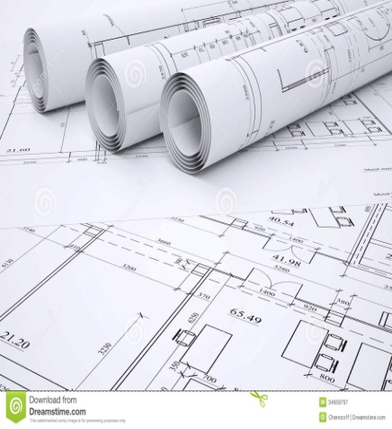
OUR SERVICES
Project Management Consultancy
Cost Management
Third Party Technical Audit
Quality & Safety Audit
Quantity Survey & BBS

Slide 7































OUR VALUED CLIENTS

Slide 8




























OUR VALUED CLIENTS

Slide 9
THE MOLETHU ADVANTAGE
VALUE FOR MONEY
DOCUMENT MANAGEMENT
ACT AS EYES & EARS OF CLIENTS
SEAMLESS COORDINATION
QUALITY OUTPUTS
TIMELY DELIVERY

Slide 10

OUR STRENGTH
Our Professional team consists of
Project Managers
Civil Engineers
Planning Engineers
Cost Managers
Billing Engineers
MEP Engineers
Quantity Surveyors
Quality Engineers
Safety Engineers
Project Coordinators

Slide 11
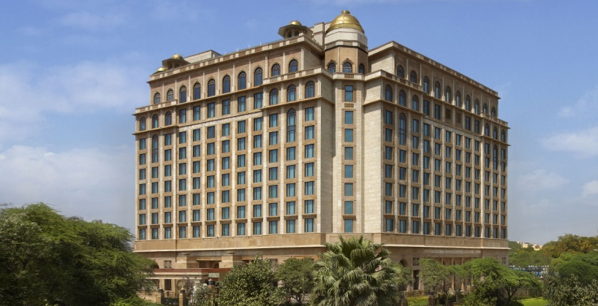
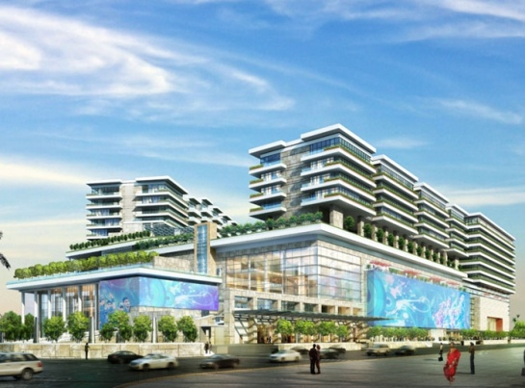
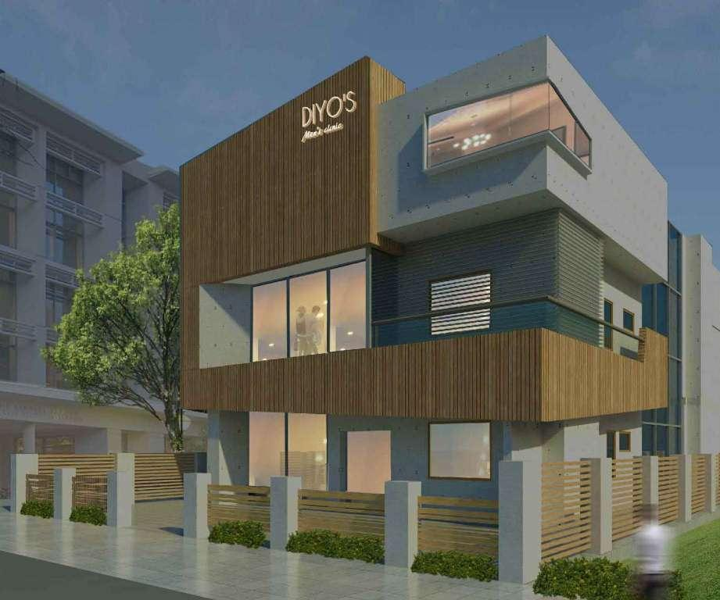
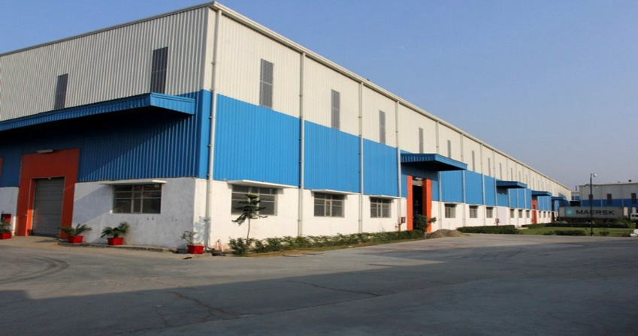
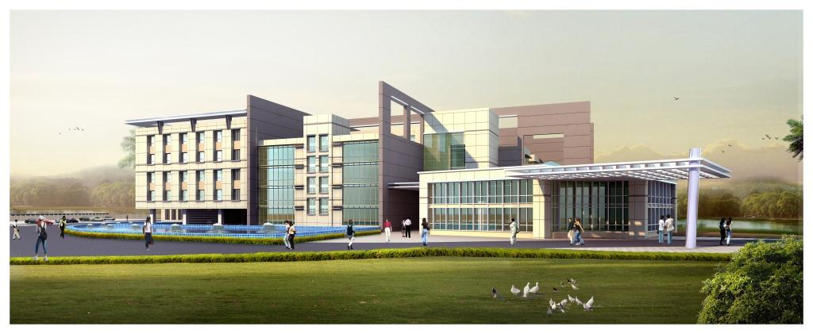
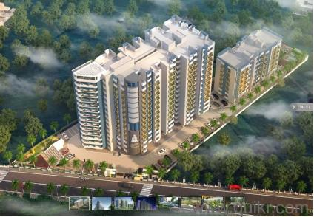
OUR EXPERTISE
HOTELS
COMMERCIAL
HOSPITALS
INDUSTRIAL
INSTITUTIONS
RESIDENTIAL

Slide 12
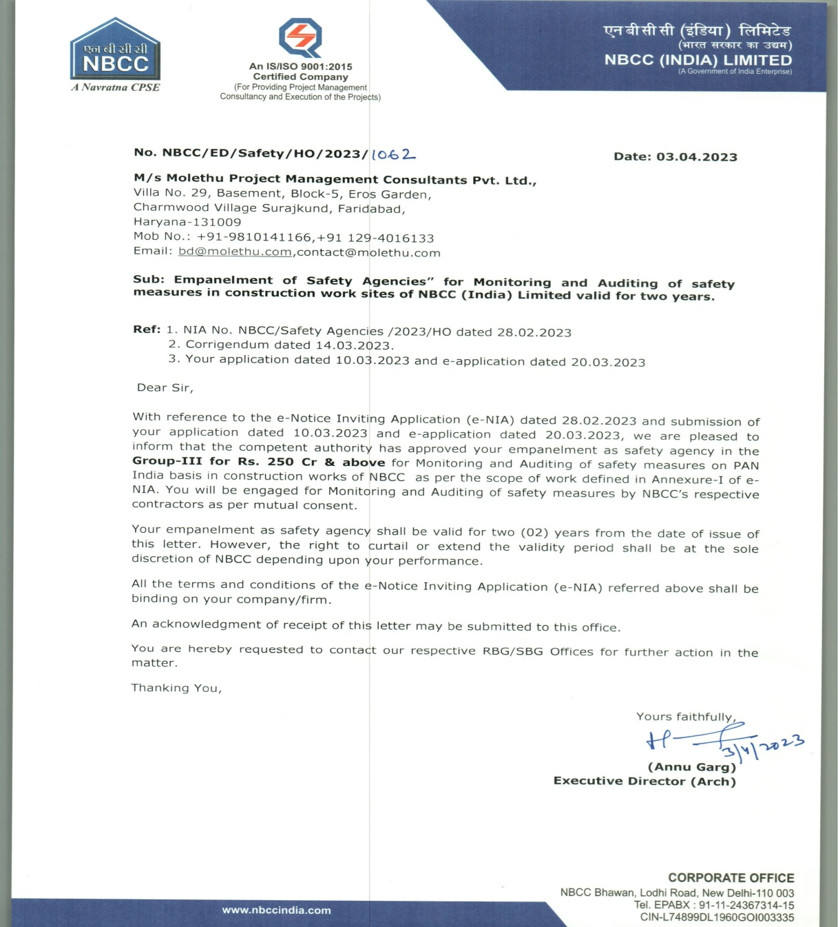
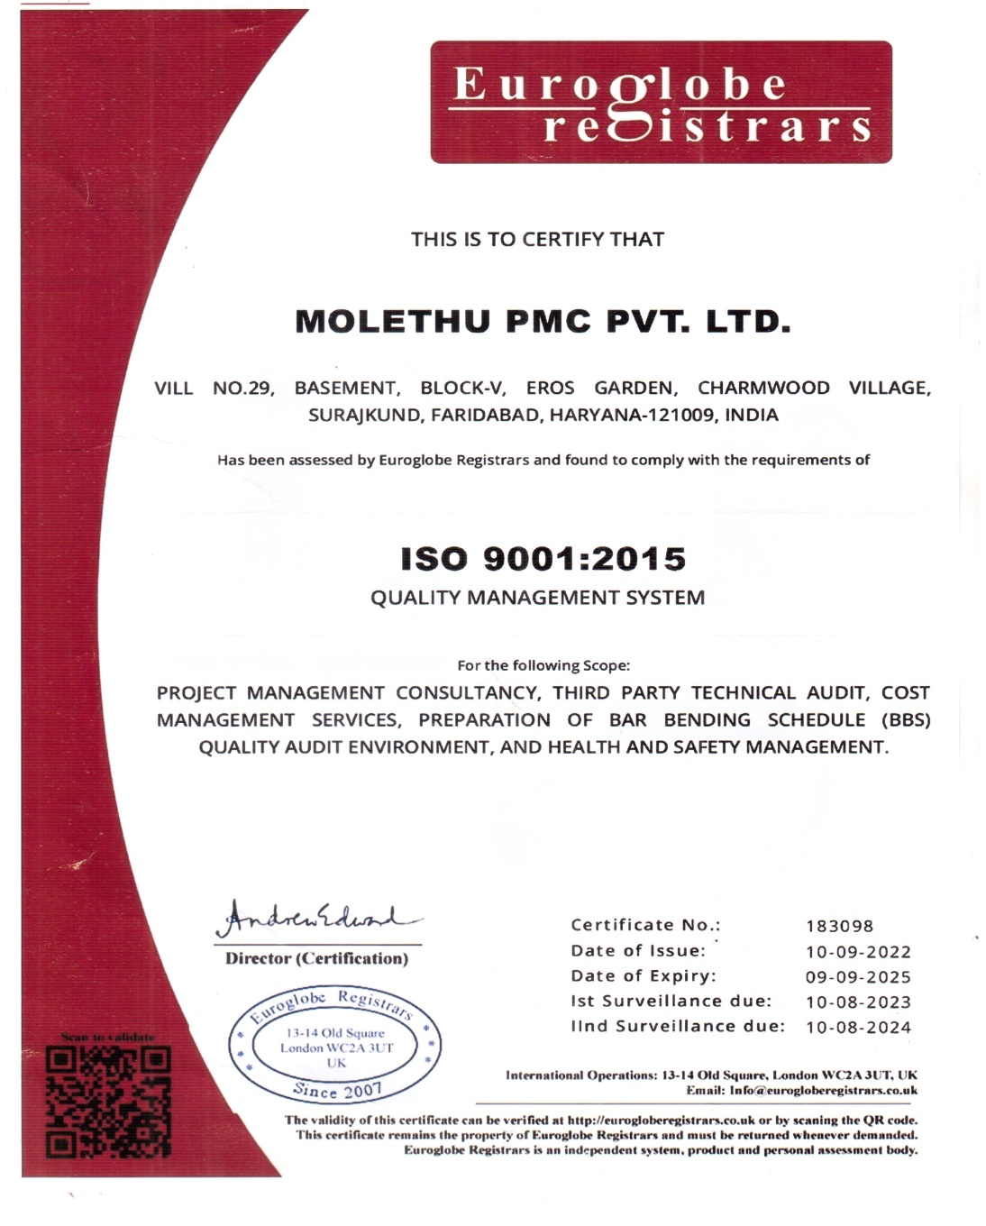
NBCC SAFETY EMPANELMENT & ISO 9001:2015
Innovation
Transparency
Bess Ethics
Respect
Integrity

Slide 13

PROJECT
PHOTOGRAPHS

Slide 14
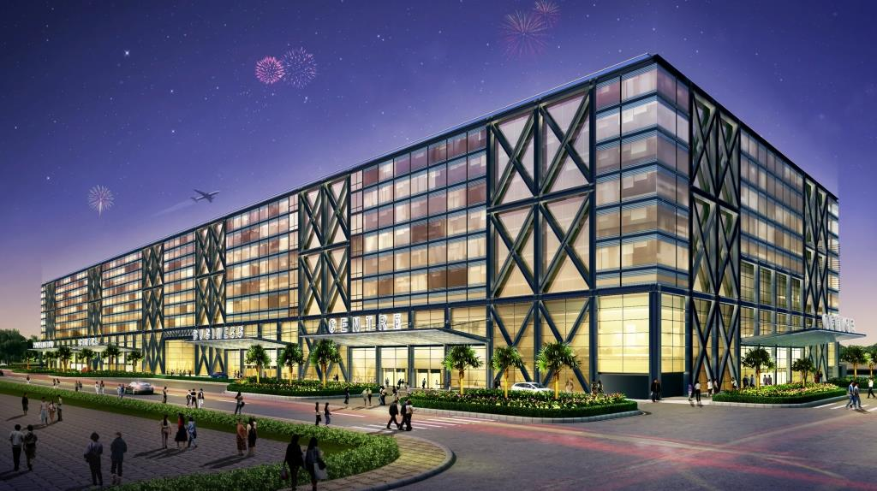
Prestige Trade Centre – Hotel Marriot Marquis + Hotel St. Regis + Commercial Spaces, Aerocity,
New Delhi

Slide 15
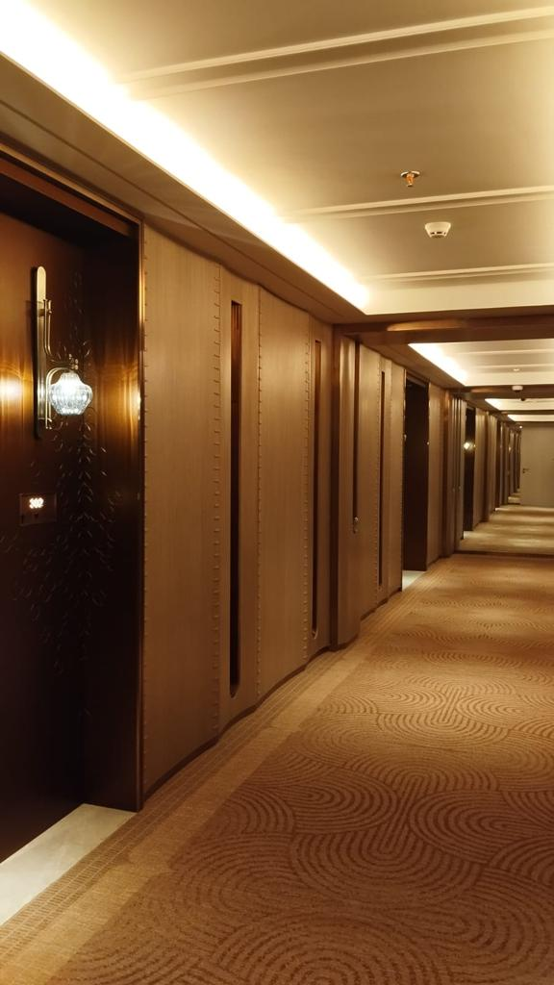
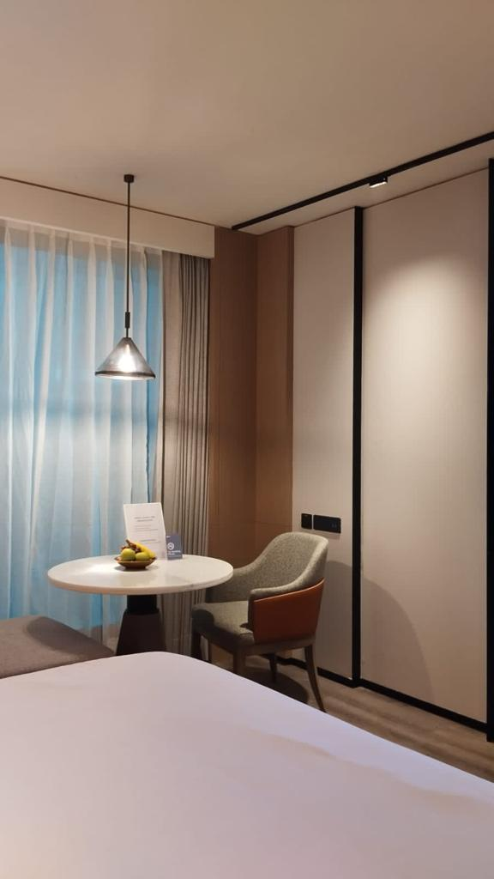
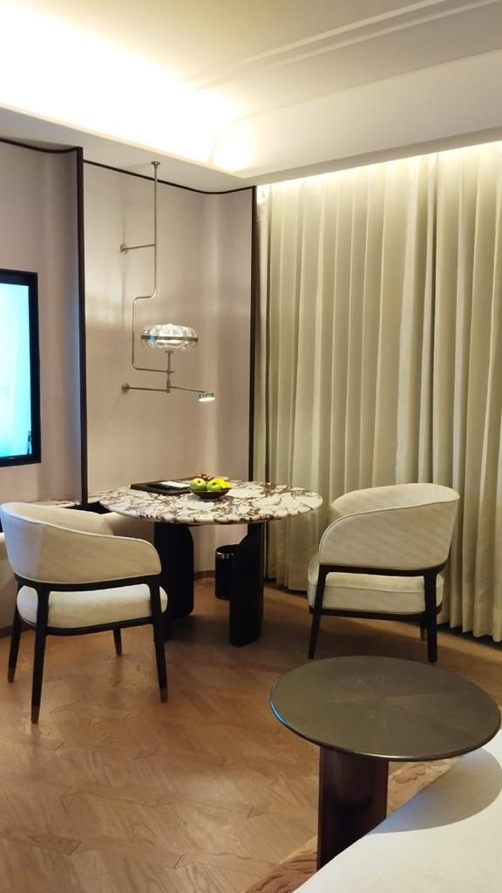
Prestige Trade Centre, Aerocity, Delhi

Slide 16
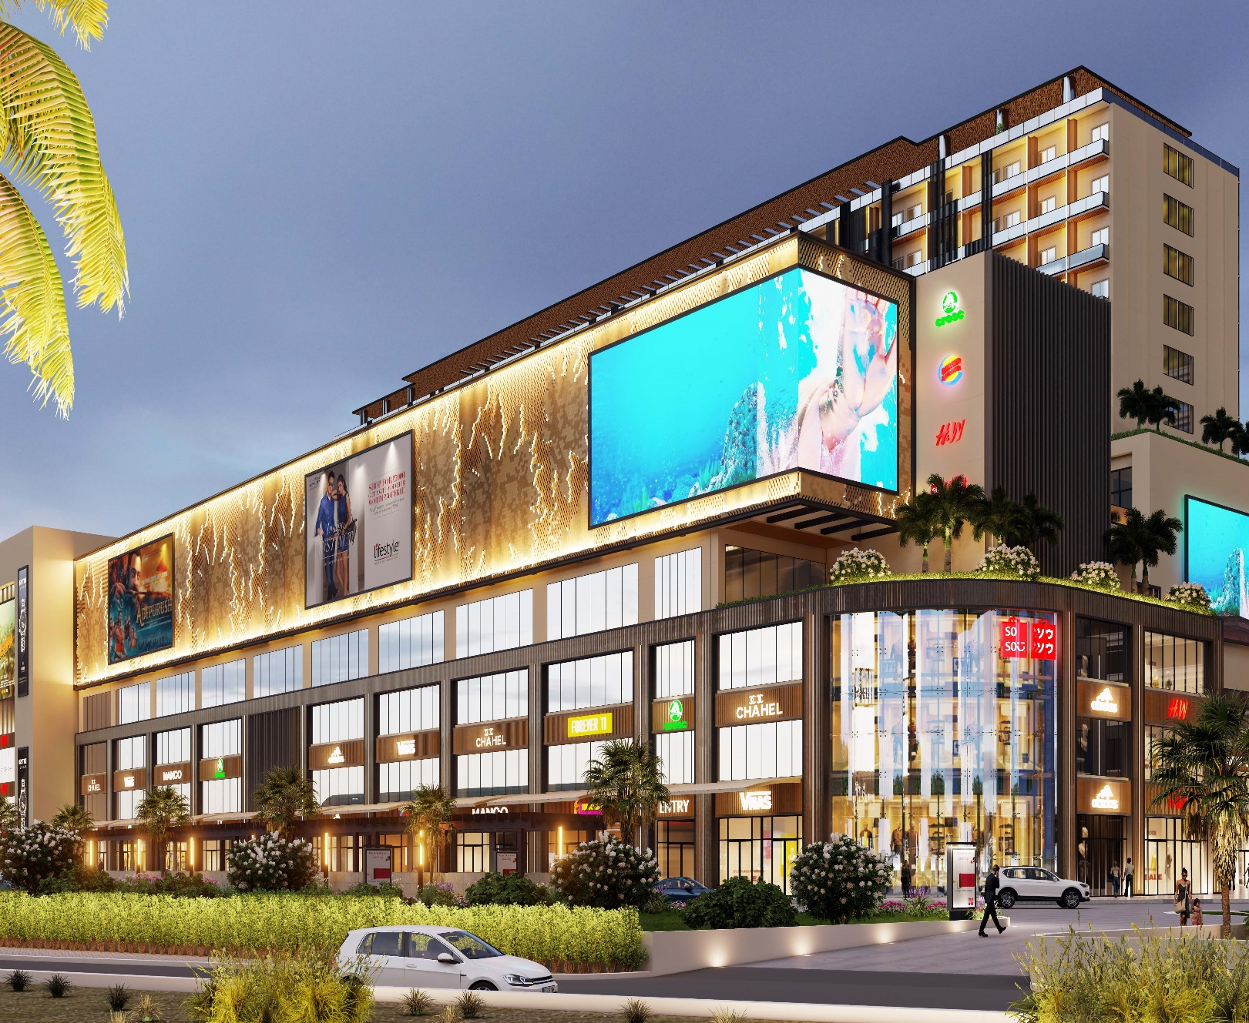
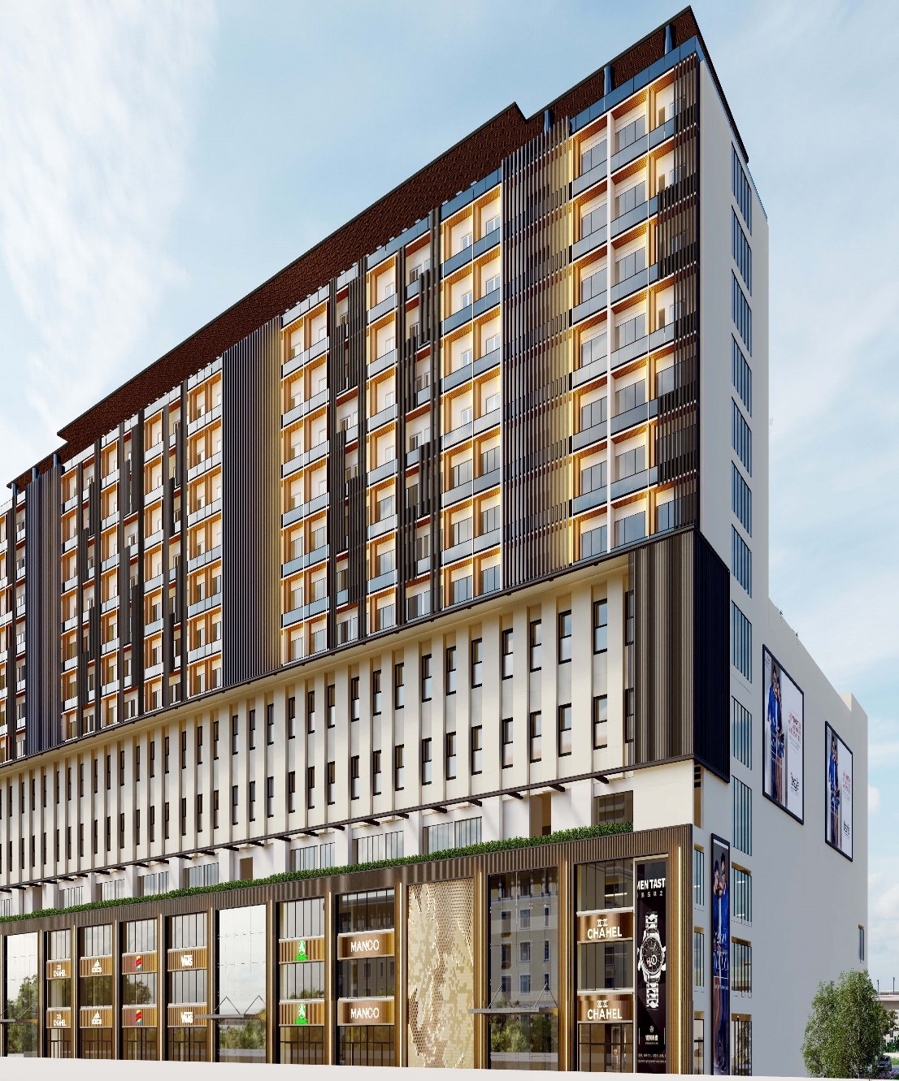
Devsai 52 Avenue, Sec-52, Noida-Commercial Project (Mall, Shopping Complex, Cinema Hall)

Slide 17
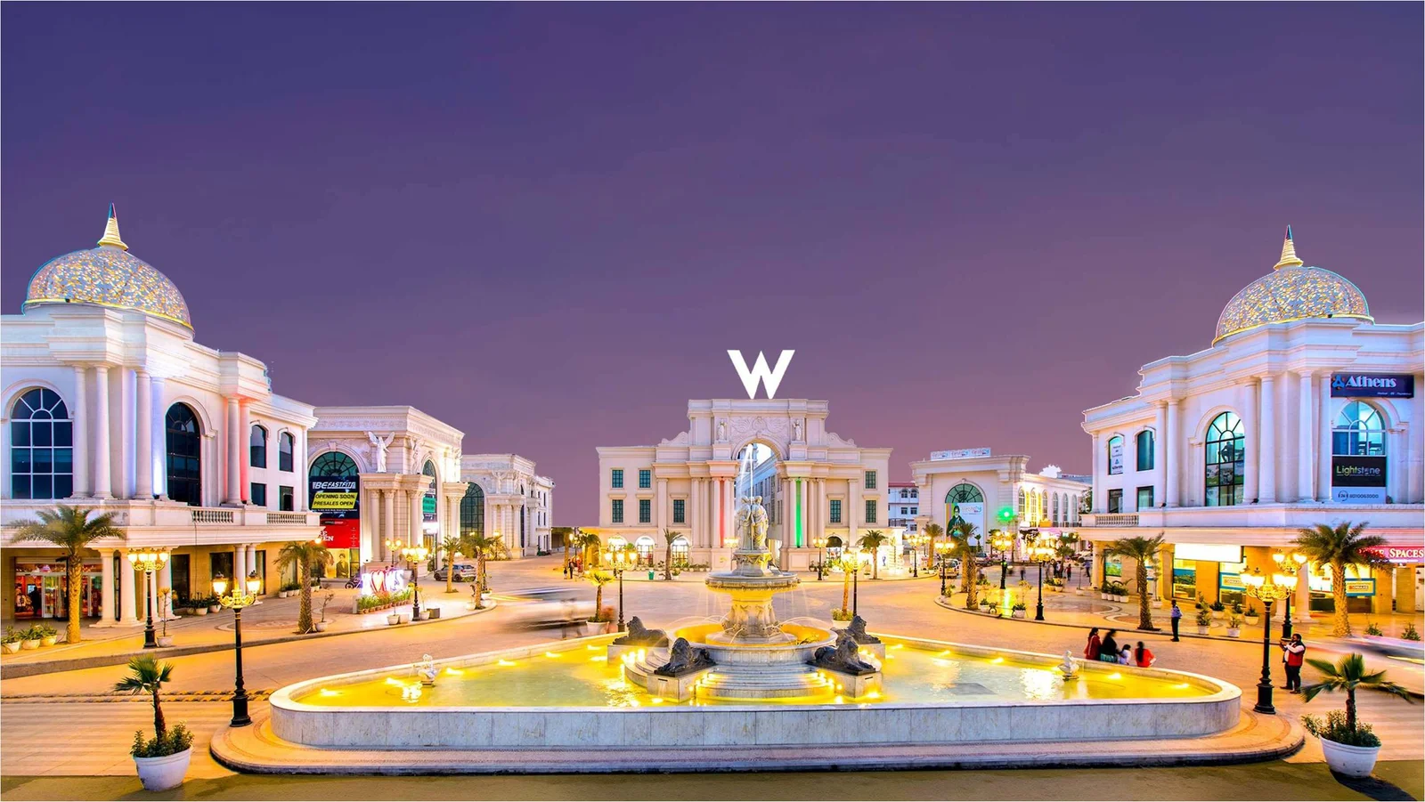
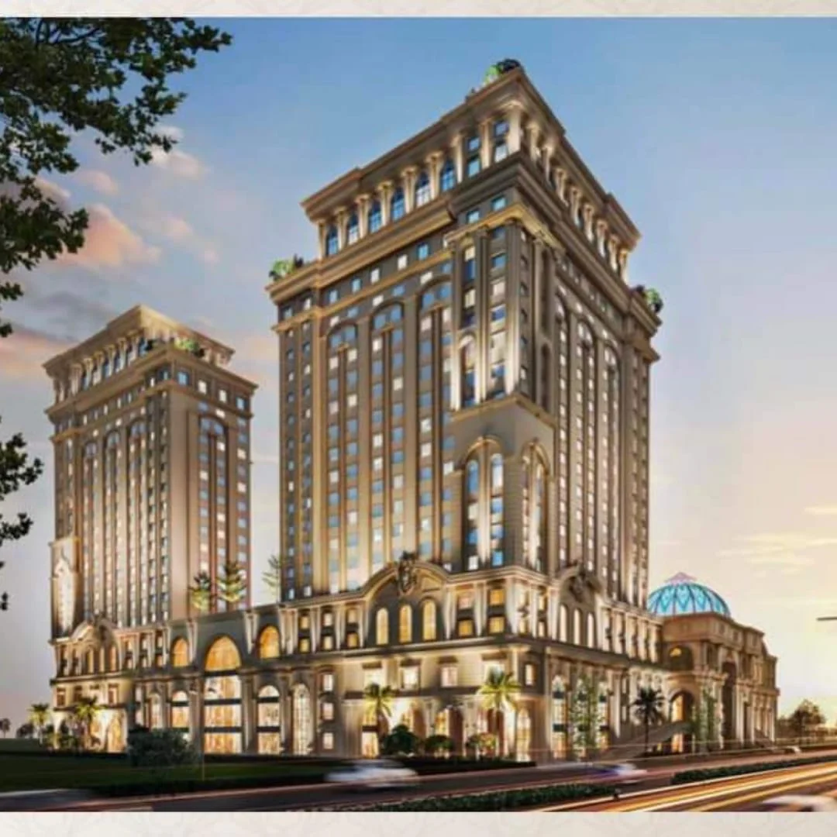
One of India’s biggest luxury Mall Omaxe World Street, Sector 79, Faridabad.

Slide 18
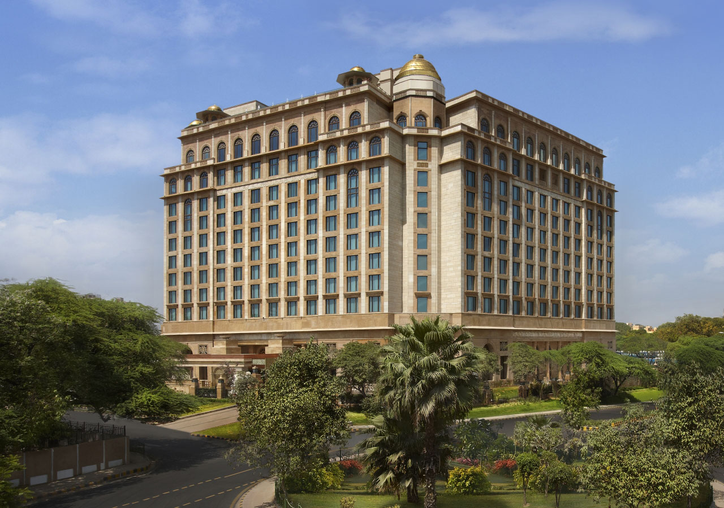
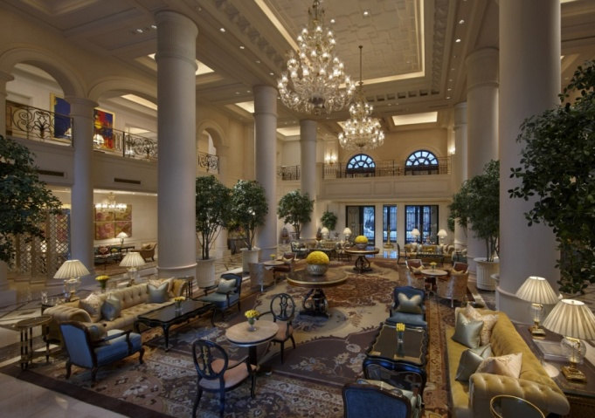

Hotel Leela Palace, Chanakyapuri

Slide 19
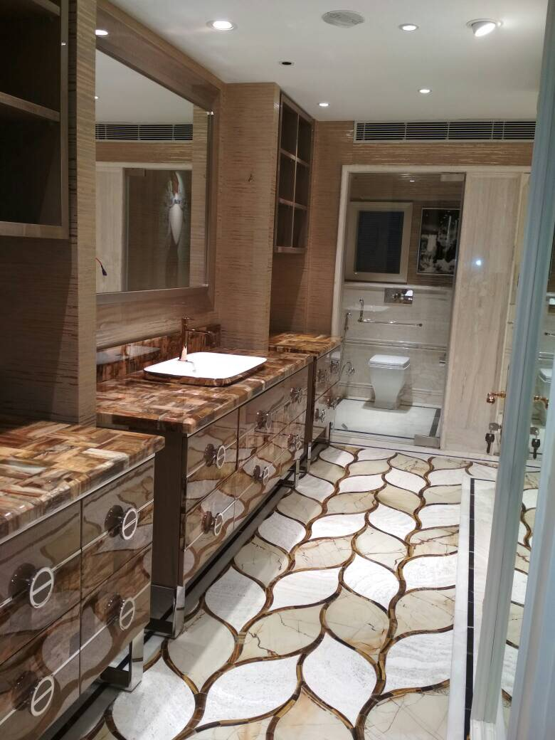
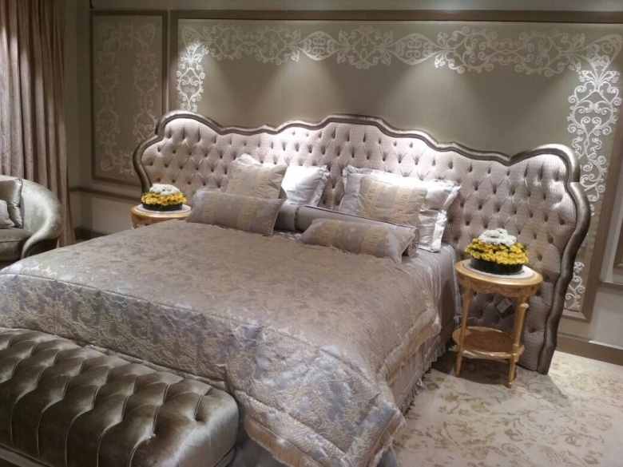
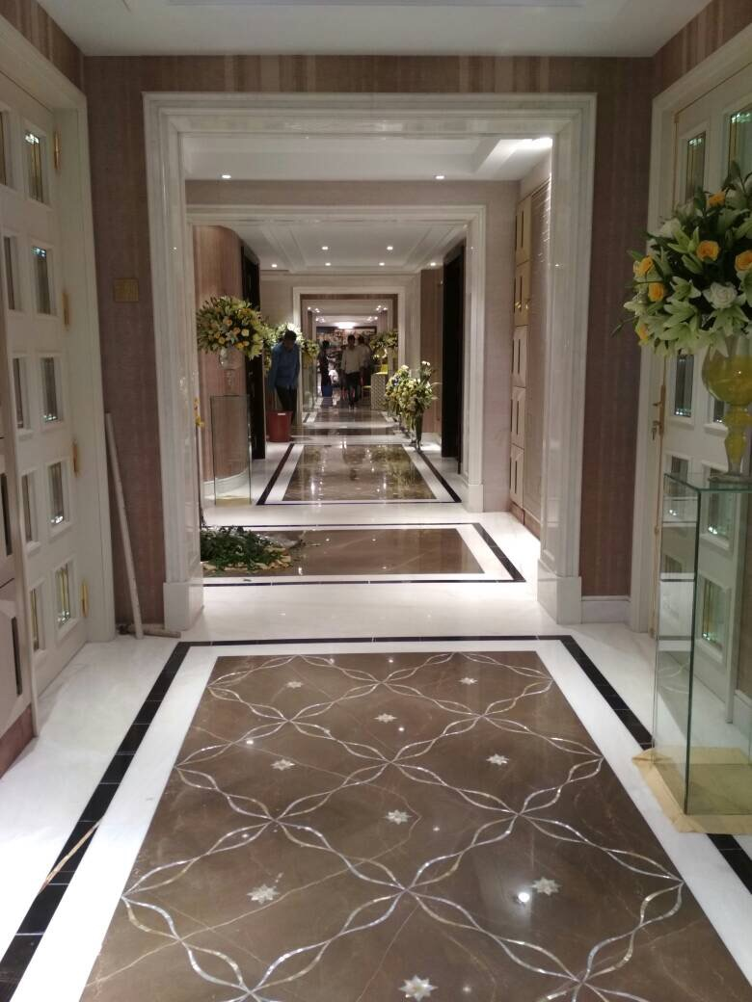
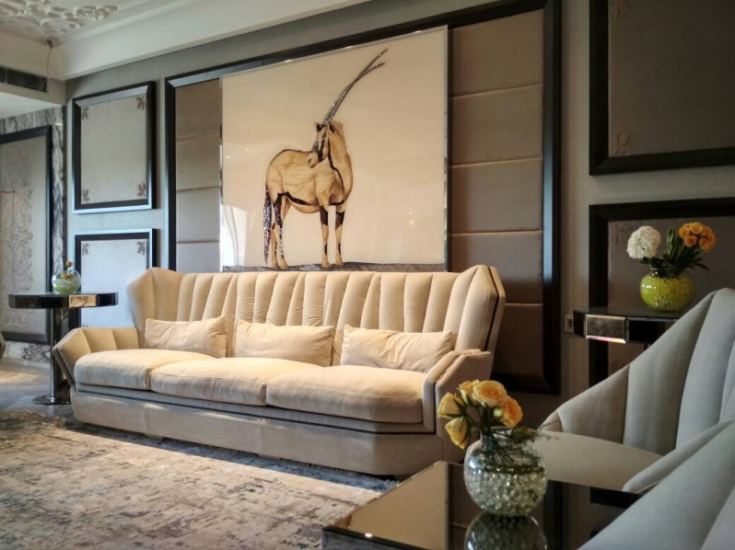
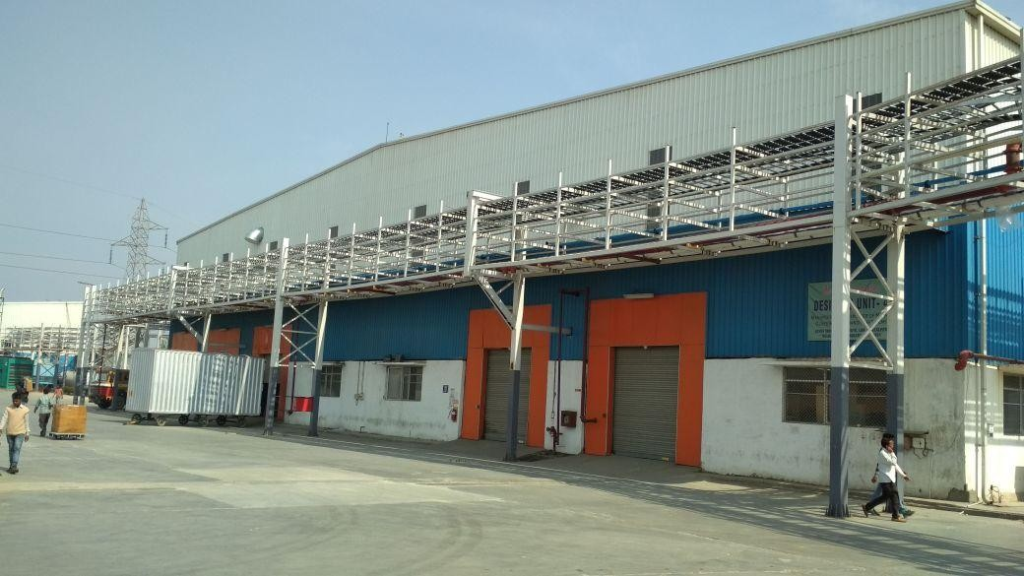
Rajalakshmi Residence, Gurgaon

Slide 20
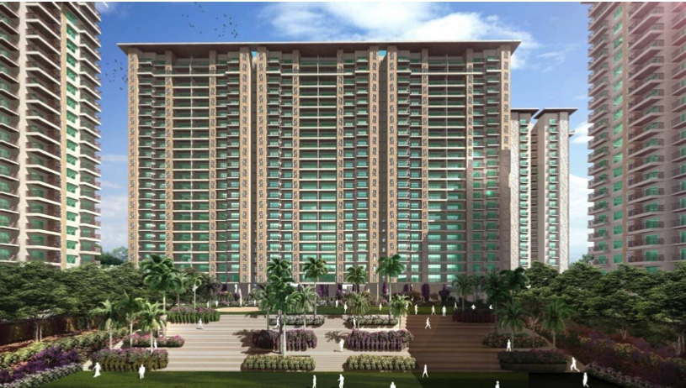
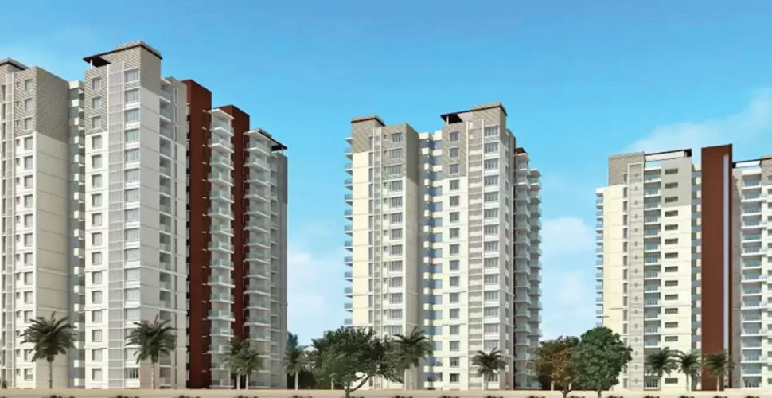
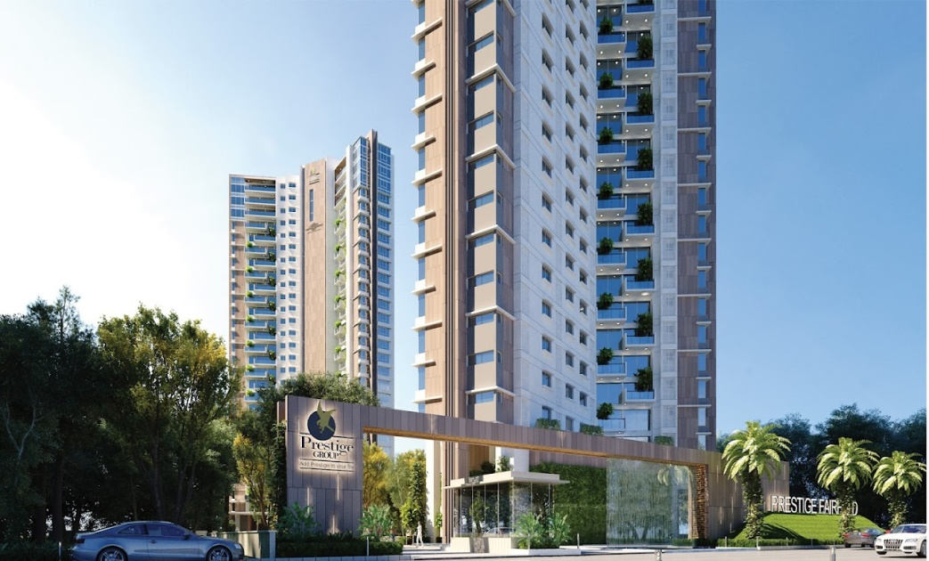
Prestige Bougainvillea Gardens in Sector 150, Greater Noida

Slide 21
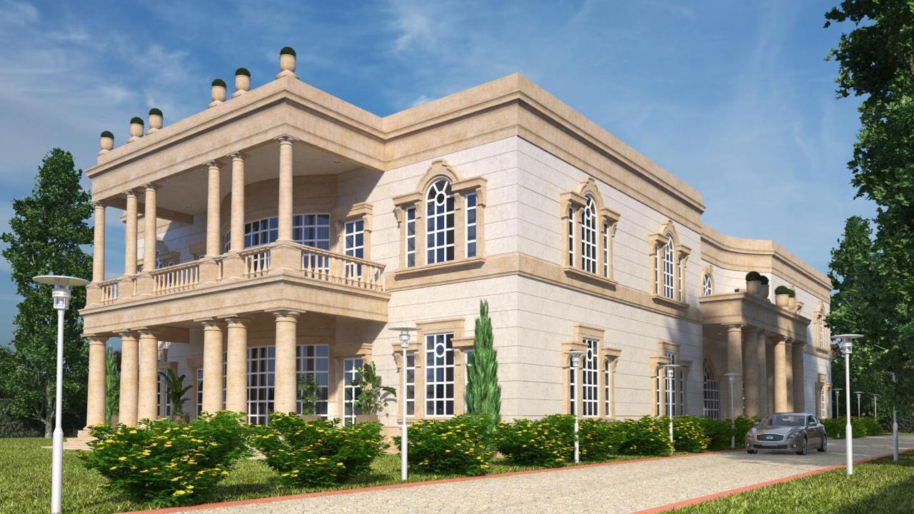
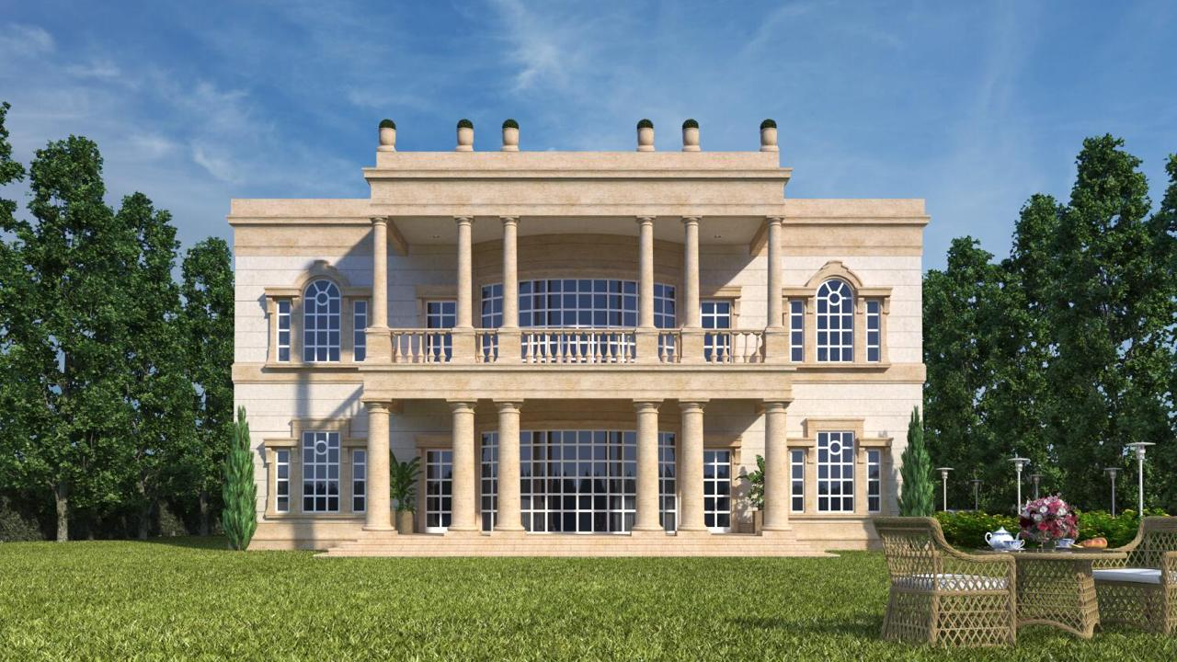
SKN Farm House, Delhi

Slide 22
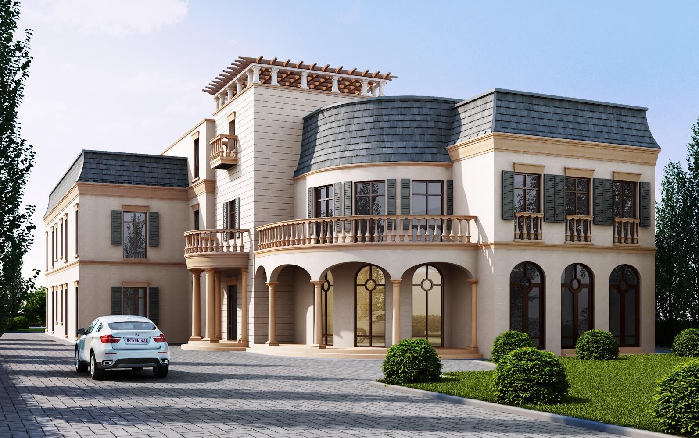
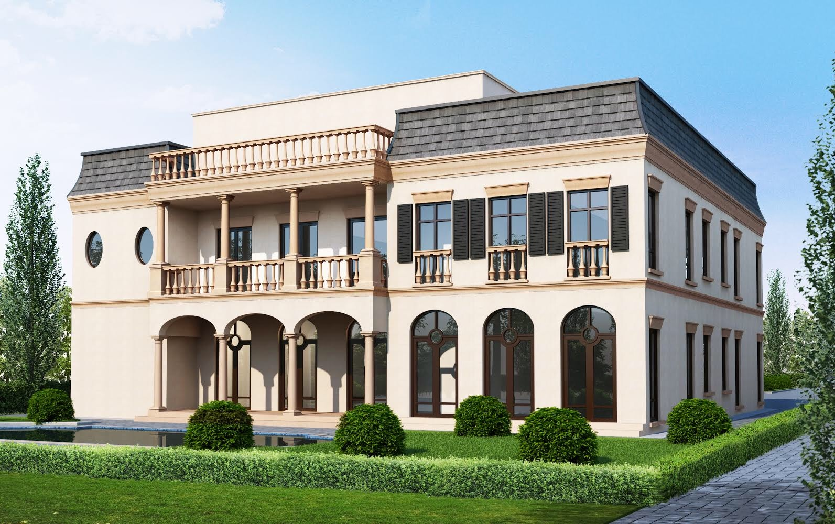
Kler House, Chandigarh

Slide 23
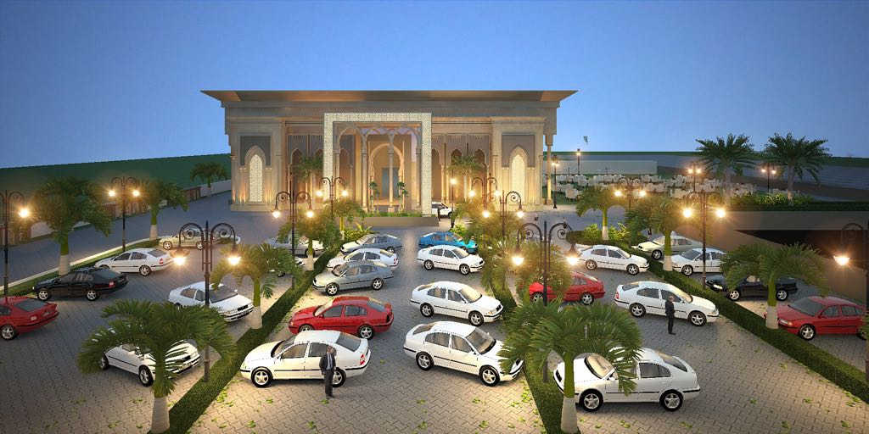
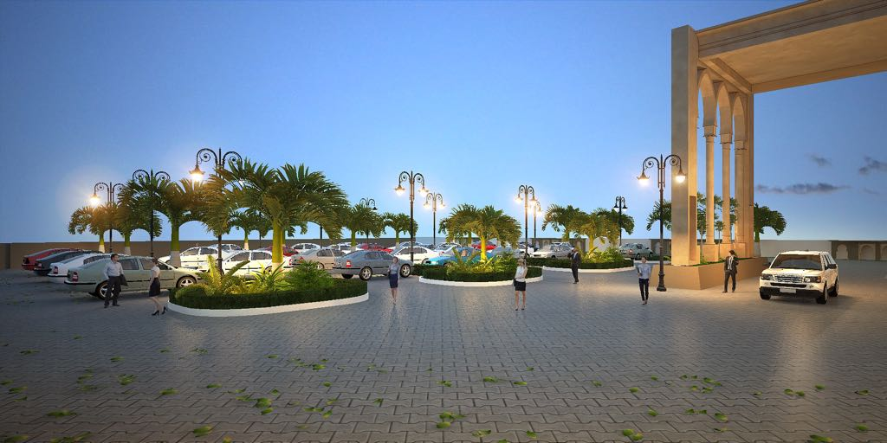
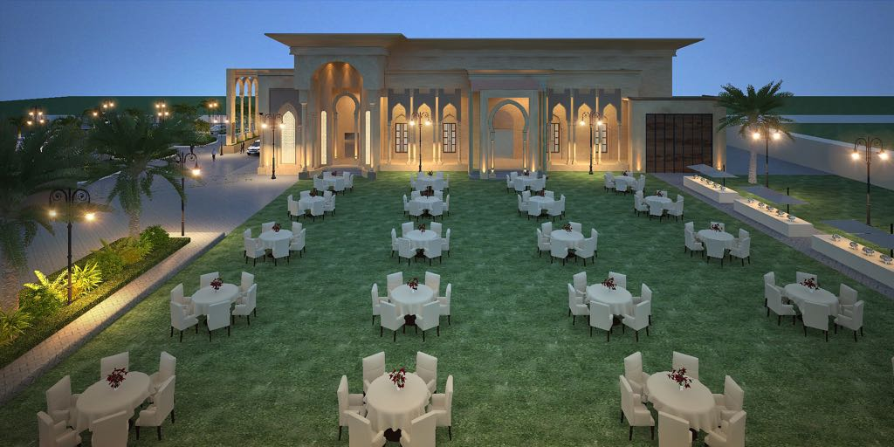
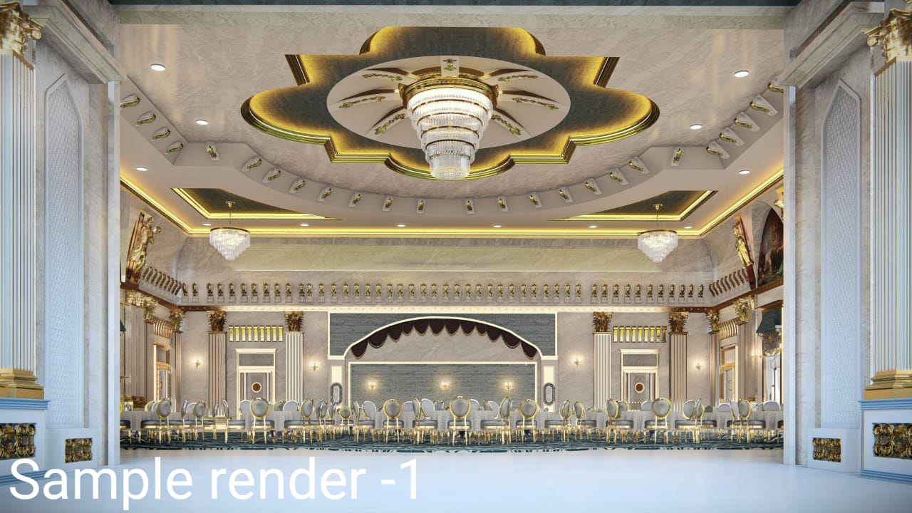
Wedding Palace at Batala, Punjab

Slide 24
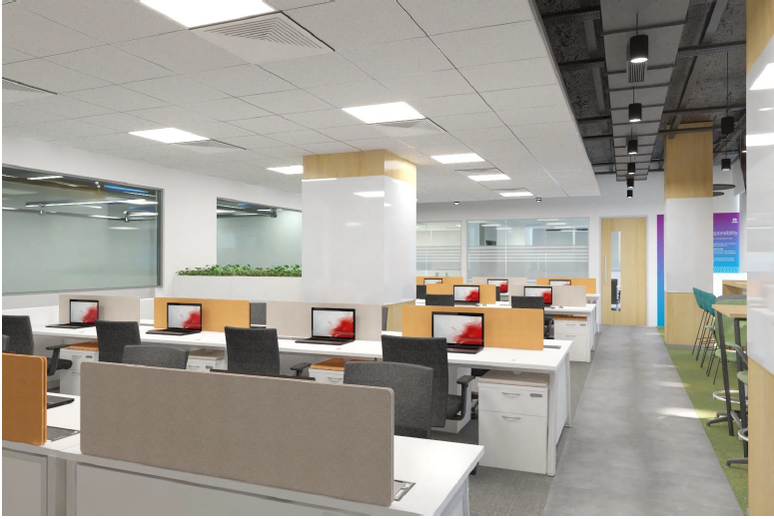
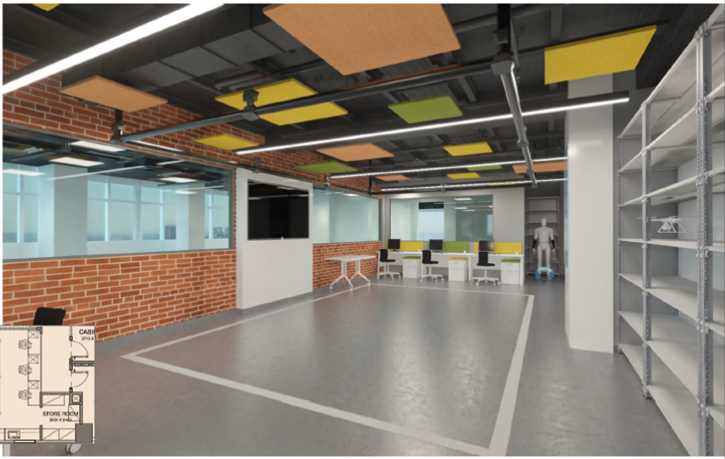
TCS Research & Innovation Park + Office, IIT Hauz Khas, Delhi
Office Area
Robotic Lab

Slide 25
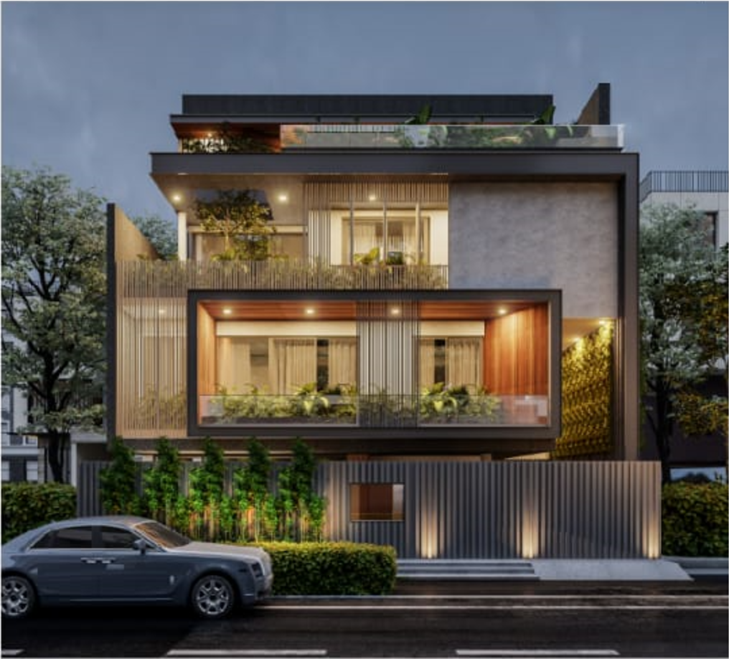
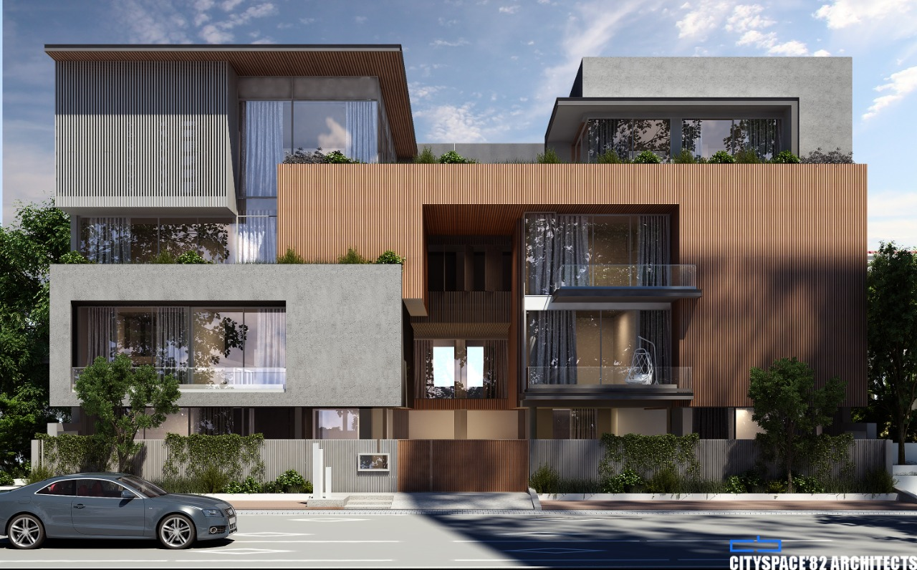
J50 Residence, South City 1, Gurgaon
J27 & J28 Residences, South City 1, Gurgaon

Slide 26
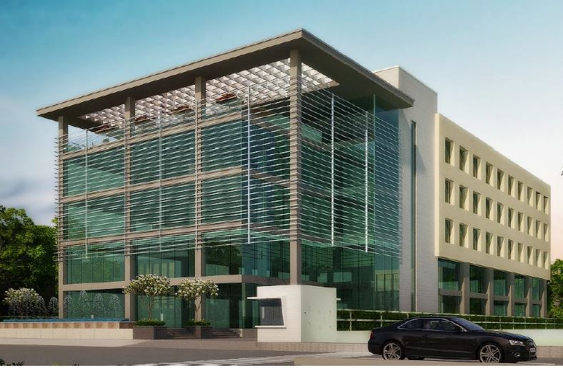
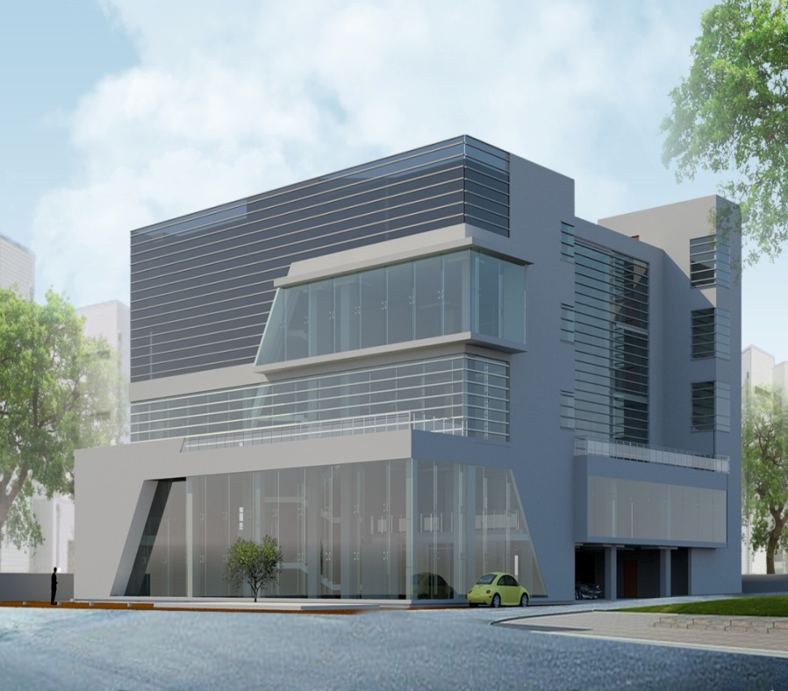
BVM, Corporate Office, MCIE, Delhi
(with complete Interior fit-outs)
Blackberry’s Corporate Office, Gurgaon (with complete Interior fit-outs)

Slide 27
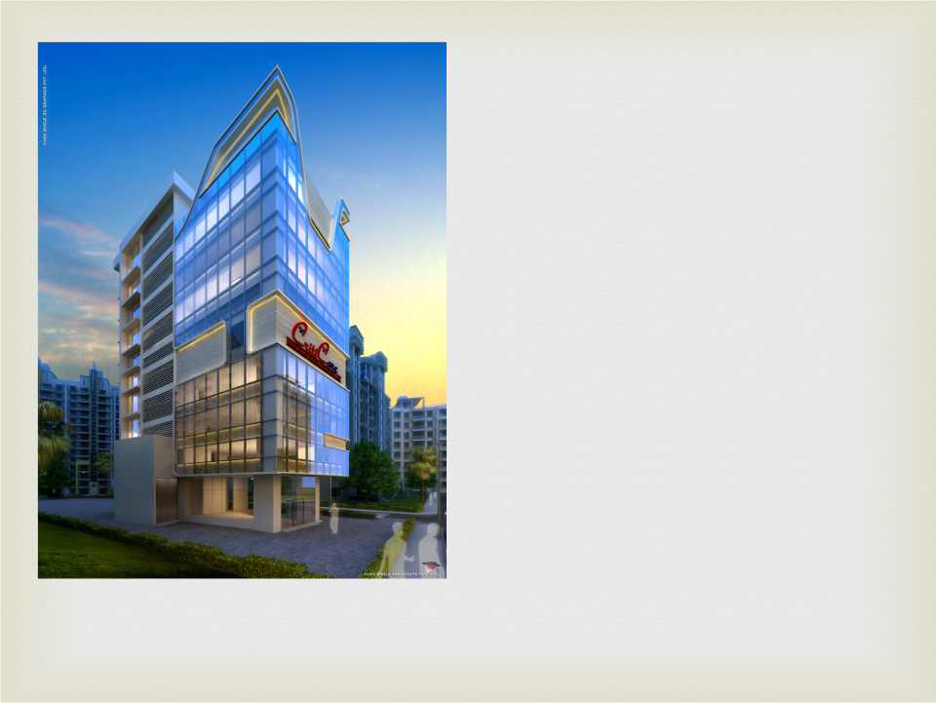
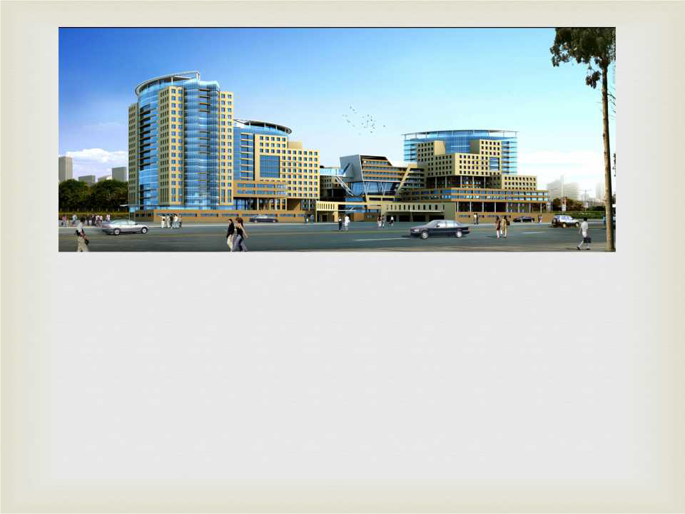
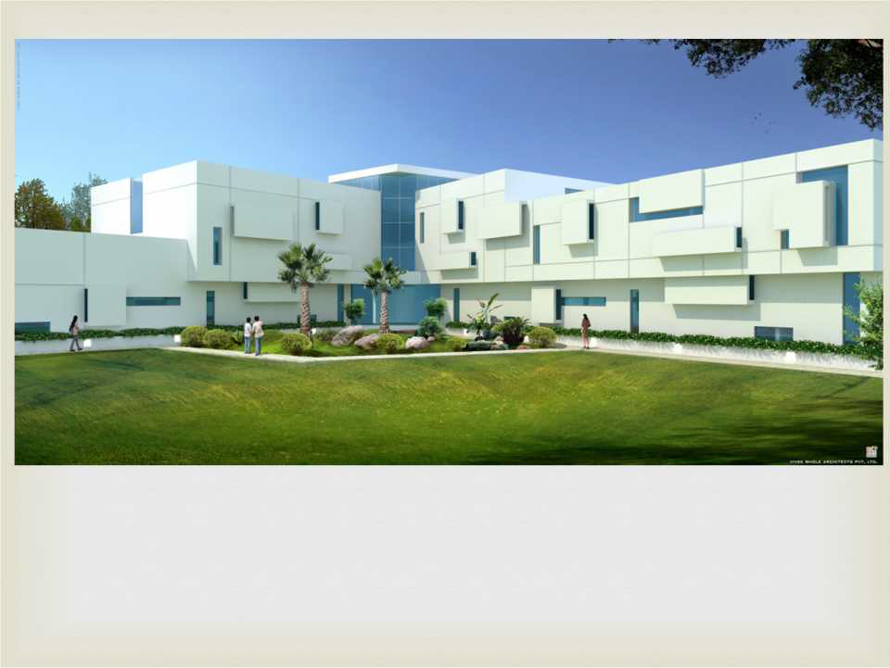
Criticare Hospital, Mumbai
Kasturba Hospital, Greater Mumbai
Sun Shine Wellness Center Vashi, Mumbai
Diyos Men's Clinic, New Delhi

Slide 28
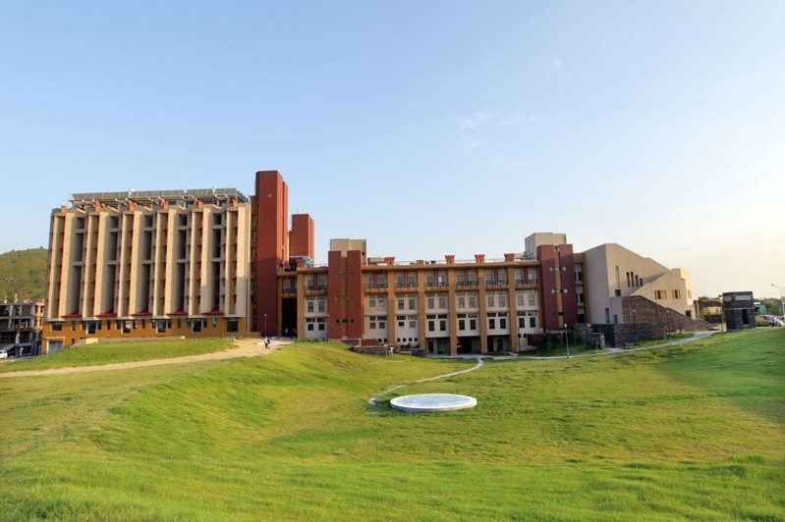
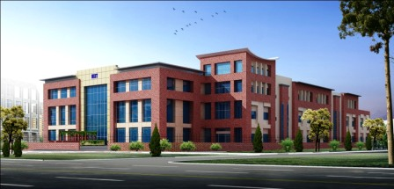
NIIT Infocity, Gurugram
NIIT University Phase-I, Rajasthan
Institute Of Chartered Accountant Of India Centre Of Excellence, Jaipur

Slide 29
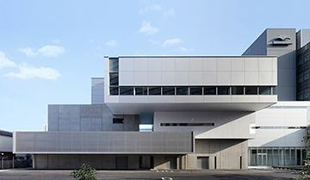
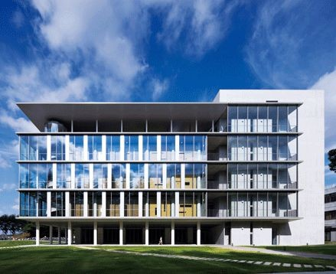
SOIL Group, MBA Institute, Manesar

Slide 30
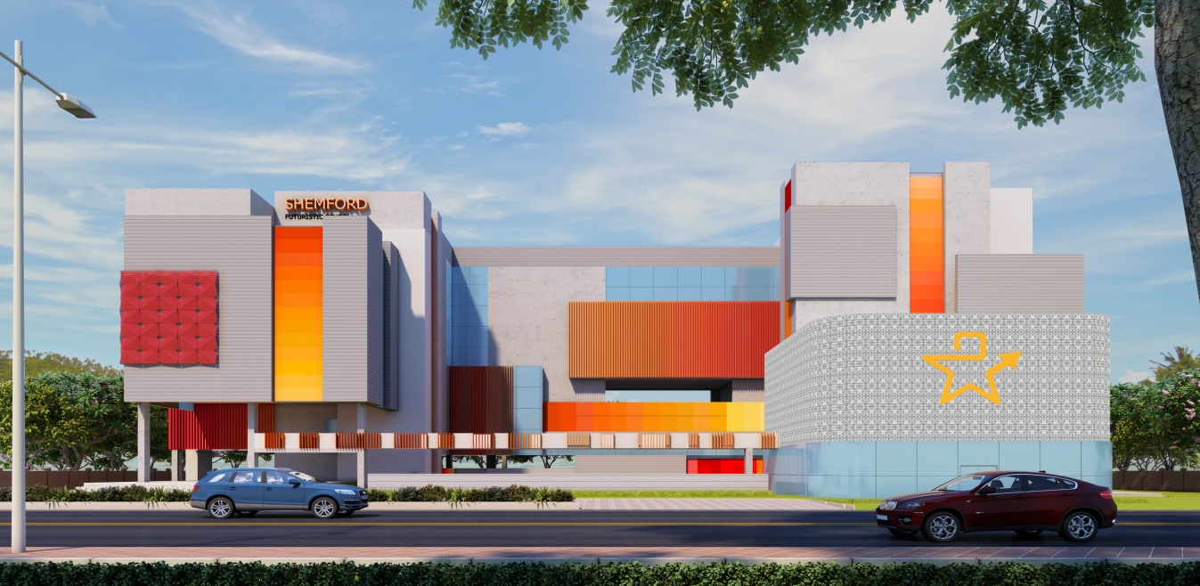
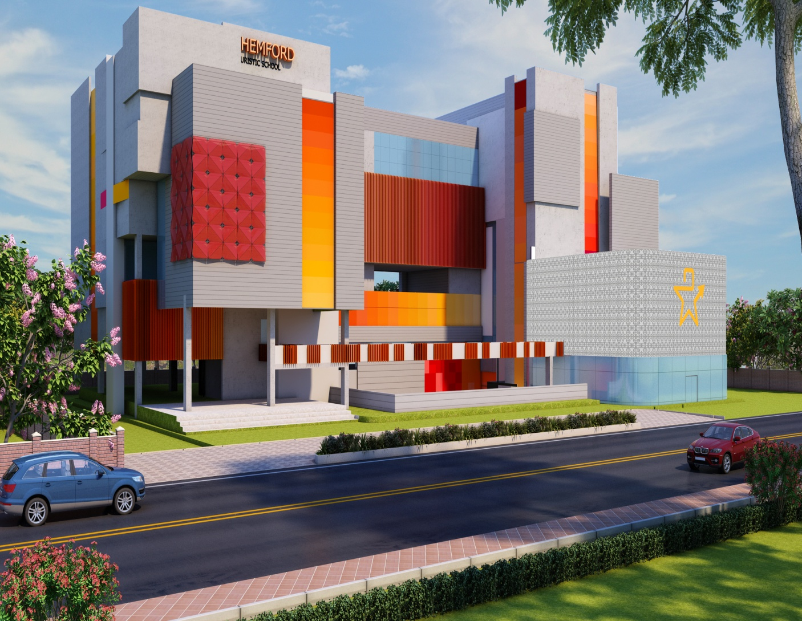

Shemford School, Gurugram
(with complete Interior fit-outs)

Slide 31



Development of Permanent Campus, Phase 1, IIM Sambalpur

Slide 32


CBSE Headquarter Building Project, Sector 23, dwarka, New Delhi
Construction of additional Exhibition cum Conventional Hall at KTPO, Bangalore.

Slide 33



All India Institute of Ayurveda, Naturopathy & Yoga (AIIA), Goa
Pt. Jawaharlal Nehru Medical College & Hospital (Phase-1), Chamba, Himachal Pradesh.

Slide 34




Brisk Infra - Lumbini Terrace Homes, Gurgaon
Emerald Greens, Siliguri West Bengal
Rudra Samridhi, Varanasi
Rudra Prestige, Varanasi

Slide 35



Rudra Buddha Enclave, Varanasi
Rudra Aishwaryam, Varanasi
CHD Lifestyle Premiere Housing, Karnal

Slide 36




Green Valley Apartments, Bihar

Slide 37




La Tropicana, Delhi
Chintels Paradiso, Gurgaon
International Convention Centre, Mumbai
Dwarika City Centre,
Muzaffarpur

Slide 38




CHD Danapani Food Court,
Karnal
Grewal Farm House,
New Delhi
DLF Capital Greens,
Moti Nagar
Unitech Vista,
Gurgaon

Slide 39


Rudra Twin Tower,
Lucknow
The- Parsvnath, New Delhi

Slide 40



The Claridges, Faridabad
Earth Sapphire Court, Greater Noida
Earth Iconic, Gurugram

Slide 41




Redevelopment of GPRA Colony, Netaji Nagar, New Delhi

Slide 42




Designco Office, Moradabad

Slide 43




Corporate Office, Muthoot Group

Slide 44



Quality Audit - Max Bupa Outlets in 10 Locations

Slide 45




DLF Camellias, Gurgaon

Slide 46



Warehouse at Kidderpore Port, Kolkata

Slide 47




Warehouse Project – Dharini Estates Pvt. Ltd.

Slide 48



Designco Factory, Moradabad

Slide 49




Katai Shed, Designco Factory, Moradabad

Slide 50


Presto Factory , Faridabad

Slide 51



ACCIL Factory Building, Daruhera

Slide 52
LIST OF PROJECTS

Slide 53
HOTELS, COMMERCIAL & INDUSTRIAL PROJECTS
Sl.No. | Projects | Client | Project Cost In Rs. (Million) | Area Sq Ft
1 | Prestige Trade Centre – Hotel Marriot Marquis + Hotel St. Regis + Commercial Spaces, Aerocity, New Delhi | Bamboo Hotel and Global Centre(Delhi) Pvt. Ltd. | 20000 | 35, 00, 000
2 | Hotel Claridges, Surajkund – Ph I. | Hotel Claridges. | 2,215 | 4, 43, 000
3 | Hotel Claridges, Surajkund – Ph II. | Hotel Claridges. | 600 | 1, 20, 000
4 | Hotel Leela Kempinski, Chanakyapuri. | Hotel Leela Kempinski, New Delhi. | 100 | 3 Acres
5 | Hotel Holiday Inn - Renovation and Upgradation, Aerocity, New Delhi | Wave Hospitality Pvt. Ltd. | 20 | 5,000
6 | Sapphire Commercial Building, Knowledge Park-5, Greater Noida -G+ BMT+ 19 Floors. | Earth Infrastructures Ltd. | 1880 | 7, 50, 000
7 | Paradise Mall, Delhi. | Architect Bureau, Vasant Vihar. | 300 | 1, 50, 000
8 | Nallambakkam Resorts, Chennai. | Unitech Ltd., Gurgaon. | 1000 | 400 acres

Slide 54
Sl.No. | Projects | Client | Project Cost In Rs. (Million) | Area Sq Ft
Project Management
9 | Old wood Building 1 & 2 | DesignCo/ Lohia Group. | - | 80000
10 | Old wood Building 3 & 4 | DesignCo/ Lohia Group. | - | 70000
11 | Slitting Shed GF & Mezz Floor | DesignCo/ Lohia Group. | - | 30000
12 | Slitting Wire Cutting Bridge | DesignCo/ Lohia Group. | - | 750
13 | Old Wood Services Bridge | DesignCo/ Lohia Group. | - | 1000
14 | Richa Dinning | DesignCo/ Lohia Group. | - | 300
15 | Corrugation Shed | DesignCo/ Lohia Group. | - | 90000
16 | Powder Coating Shed – Mezz Floor | DesignCo/ Lohia Group. | - | 10000
17 | Kora Canteen Shed | DesignCo/ Lohia Group. | - | 25000
18 | Katai Shed | DesignCo/ Lohia Group. | - | 3000
19 | Shiva building | DesignCo/ Lohia Group. | - | 65000

Slide 55
Sl.No. | Projects | Client | Project Cost In Rs. (Million) | Area Sq Ft
Project Management
20 | Cafeterias, Office, Dispensary & Interior Works of a Factory, Moradabad. | DesignCo/ Lohia Group. | - | 40000
21 | Krishna Building | DesignCo/ Lohia Group. | - | 60000
22 | Civil, Electrical, Sanitary & Water Supply works of Factory Building, Service Building, Sub-station Building, Boiler Room, Guard Shed and Other External Services works. | Asian Consumer Care Pvt. Ltd.,Dhaka. | 300 | 1, 00, 000
23 | Factory Building, ACCIL Steels Ltd., Daruhera. | ACCIL Steels Ltd. | 150 | 1, 00, 000
24 | Third Party Technical Audit & Bill Verification – LNG Import, storage & Regasification Terminal Project | SNS Infraprojects Pvt. Ltd | 1100 | 10 Acres
25 | Warehouse at Kidderpore Port, Kolkata. | Transworld Terminal Pvt. Ltd. | 250 | 10 Acres
27 | Commercial Office for Schneider Electric India Pvt. Ltd., Gurgaon. | Schneider Electric India Pvt. Ltd. | 198 | 79,000
28 | Construction of Centre of Excellence for ICAI Phase- I at Jaipur, Rajasthan. | ICAI, New Delhi. | 1250 | 5, 00, 000
29 | Software Development Centre, NIIT, Infocity, Gurgaon. | NIIT, Gurgaon. | 320 | 1, 50, 000
30 | Corporate Office Building, Muthoot Finance Ltd. | Muthoot Finance Ltd. | 200 | 80, 000

Slide 56
Sl.No. | Projects | Client | Project Cost In Rs. (Million) | Area Sq Ft
Project Management
31 | Rehani Indicon | DesignCo/ Lohia Group. | - | -
32 | Interior, MEP & Finishing Works, for Teleperformance, Jaipur. | Teleperformance. | 50 | 1, 00, 000
33 | Blackberry’s Corporate Office For Mohan Clothing. | Petrole Services (India) Pvt. Ltd. | 250 | 1, 00, 000
34 | Construction of Dwarika City Centre Shopping Mall Cum Multiplex, Muzaffarpur, Bihar. | ReIndia Property Management Pvt. Ltd. | 400 | 2, 00, 000
35 | IT Space including 2 BMT + GF+ 6 floors. Plot no. 100, Ph. I, Gurgaon. | Unitech Ltd., Gurgaon. | 120 | 1, 00, 000
36 | Commercial base Kitchen, for all Theobroma outlets in Delhi, Okhla. | Theobroma Foods pvt.ltd. | 50 | 15, 000
37 | Devsai 52 Avenue, Sec-52, Noida-Commercial Project (Mall, Shopping Complex, Cinema Hall) | MMR Group | 4200 | 12,00,000
38 | TCS Research & Innovation Park + Office, IIT Hauz Khas, Delhi | TCS/ Vijay Punjabi Consultants Pvt. Ltd. | 14 | 5,000

Slide 57
GOVT. PROJECTS
Sl.No. | Projects | Client | Project Cost In Rs. (Million) | Area Sq Ft
1 | Construction of Centre of Excellence for ICAI Phase- I at Jaipur, Rajasthan. | ICAI, New Delhi. | 1250 | 5, 00, 000
2 | Defense Project For Tata Power Company Ltd. at IMT, Faridabad. | M/s. Daga Trading Co Pvt. Ltd. | 600 | 8,00,000
3 | Indian International Institute of Democracy & Election Management at Dwarka. | Daga Trading Co Pvt. Ltd. | 1000 | 10,00,000
4 | All India Institute of Ayurveda, Naturopathy & Yoga (AIIA), Goa. | Dee Vee Projects Ltd. | 1,750 | 5,00,000
5 | Pt. Jawaharlal Nehru Medical College & Hospital (Phase-1), Chamba, Himachal Pradesh. | Ahluwalia Contracts (India) Limited. | 2,898 | 5,00,000
6 | Development of permanent Campus, Phase 1, IIM Sambalpur. | Dee Vee Projects Ltd. | 2760 | 5,00,000

Slide 58
GOVT. PROJECTS
Sl.No. | Projects | Client | Project Cost In Rs. (Million) | Area Sq Ft
7 | Redevelopment of GPRA colony at Sarojini Nagar, New Delhi (PKG-1) | Girdhari Lal Constructions Pvt. Ltd. | 8570 | 110 Acre
8 | CBSE Headquarter Building Project Sector-23, Dwarka, New Delhi | Girdhari Lal Constructions Pvt. Ltd. | 1500 | 5,00,000
9 | Redevelopment of GPRA Colony at Netaji Nagar, New Delhi | NKG Infrastructure Limited. | 13560 | -
10 | Construction of additional Exhibition cum Conventional Hall at KTPO, Bangalore. | Gopikrishna Infra Pvt. Ltd | 520 | 43056
11 | Construction of Propose Birangana Sati Sadhini State University at Golaghat, Assam | Govt. of Assam | 460 | -
12 | Construction of District Sports Complex at Saboti, North Lakhimpur ,(Phase-II) Lakhimpur District of Assam | Govt. of Assam | 410 | -
13 | Construction of proposed District Sports Stadium complex at Biswanath Chariali under Biswanath LAC, Biswanath District of Assam | Govt. of Assam | 400 | -

Slide 59
OTHER PROJECTS
Sl.No. | Projects | Client | Project Cost In Rs. (Million) | Area Sq Ft
Cost Management Services
1 | Residential Tower 4A, 4B, 5A, 5B, SEZ, Noida. | Unitech Ltd., Gurgaon. | 2400 | 12, 00, 000
2 | Uni Homes, Bhopal, Residential Tower. | Unitech Ltd., Gurgaon. | 2200 | 11, 00, 000
3 | Uni World Resorts, Gurgaon. | Unitech Ltd., Gurgaon. | 1000 | 400 Acres
4 | Princely Estates – Multi-storey Group Housing Project -27 towers, NOIDA. | Amrapali Developers Ltd. | 5000 | 28, 00, 000
5 | Vistas- Residential Tower, Gurgaon. | Unitech Ltd., Gurgaon. | 2000 | 10, 00, 000
6 | Sun Breeze - Residential Tower, Gurgaon. | Unitech Ltd., Gurgaon. | 2600 | 13, 00, 000
7 | Villas, Uniworld Resort, Gurgaon. | Unitech Ltd., Gurgaon. | 110 | 57, 000
8 | Moira Resort, Goa - Civil, Interior & MEP Services. | Ar. Vistasp Bhagwager. | 120 | 20000
9 | Resort Project in Peer Kho, Jammu - Civil, Interior & MEP Services. | Ar. Nilanjan Bhowa. | 132 | 22000

Slide 60
Sl.No. | Projects | Client | Project Cost In Rs. (Million) | Area Sq Ft
Project Management
10 | Dismantling and reconstruction of Retaining / Boundary Wall ( East Side) and relocation of MEP services. | Hotel Claridges. | 30 | 7, 000
11 | Global Ways School, Gurgaon. | Gunjan Nikunj Education Trust. | 250 | 70, 000
12 | Civil, MEP & Interior Works For Mr. Amit Arora’s Residence, Camellia, Gurgaon. | Mr. Amit Arora. | 30 | 10, 000
13 | Grewal Farmhouse, Chhattarpur, New Delhi. | Mr. Sanjay Grewal. | 90 | 5 Acres
14 | Sunshine Wellness Center, 100 Beded Drug Rehabilitation and Detoxification center, Vasai, Mumbai. | Dr. Goel. | 30 | 18,000
15 | Criticare 100 Bed Hospital at Juhu, Andheri, Mumbai. | Dr. Deepak Namjoshi. | 120 | 42,810
16 | Sapphire, Commercial Building, Knowledge Park-5, Greater Noida. | Earth Infrastructures Ltd. | 1880 | 7, 50, 000

Slide 61
Sl.No. | Projects | Client | Project Cost In Rs. (Million) | Area Sq Ft
Project Management
17 | Residential Project - Rudra Prestige, Varanasi, Uttar Pradesh. | Rudra Real Estate Ltd., New Delhi. | 120 | 80,000
18 | Residential project – GF+ BMT+ 3 floors, Espace, Nirvana Country, Gurgaon. | Mr. Vinod Narayan. | 30 | 10, 000
19 | Construction of Multi-storey Group Housing Project, Siliguri, West Bengal. | Re India Property Management Pvt. Ltd. | 400 | 2, 80, 000
20 | Rudra Samridhi, Residential Project AT Varanasi, Uttar Pradesh. | Rudra Nirman Pvt. Ltd., New Delhi. | 120 | 80,000
21 | Rudra Buddha Enclave, Residential Project at Varanasi- Tower A -B+Stilt+14 Floors and Tower B - Stilt+7 Floors. | Rudra Real Estate Pvt. Ltd. | 450 | 2,79,000
22 | Rudra Aishwaryam, Residential Project at Varanasi- B+Stilt+13 Floors. | Rudra Realtech Pvt. Ltd. | 250 | 1,58,000
23 | Infrastructure Development of Green Valley Township at Purnea, Bihar. | Green Valley Developers. | 2500 | 175 Acre
24 | Chhabra Residence,19 Pamposh Enclave, New Delhi. | Sunbeam Enterprises. | 52.5 | 15,000

Slide 62
Sl.No. | Projects | Client | Project Cost In Rs. (Million) | Area Sq Ft
Project Management
25 | Mr. Anand Mehta’s Residence, C-36, Anand Niketan, New Delhi. | Mr. Anand Mehta. | 48 | 12000
26 | Rajalakshmi Residence, Gurgaon. | Mr. Madhusudan Rao(Chairman-Lanco Infratech). | 30 | 12000
27 | Retail Outlets for Biotique in all international & domestic airports. | Biotique. | 1 each | 700 each
28 | Diyos Mens Clinic, Safdarjung Enclave. | Diyos Mens Clinic. | 100 | 10, 000
29 | Construction of Shemford school at Gurgaon. | Shemford group of schools. | 250 | 100,000
30 | MBA Institute at Manesar. | School of Inspired Leadership. | 300 | 1, 16, 000
31 | Construction of Kler House, Chandigarh. | Daws & Kahlon. | 300 | 21,000
32 | Wedding Palace, Batala, Punjab. | Salsan Steels Pvt. Ltd. | 300 | 22, 000
33 | SKN Farm House, Ghitorni, Delhi. | SKN Haryana City Distribution Pvt. Ltd. | 90 | 30,000

Slide 63
Sl.No. | Projects | Client | Project Cost In Rs. (Million) | Area Sq Ft
Project Management
34 | Construction and Development of International Peace Centre, Delhi. | Bharat Soka Gakkai. | 150 | 45, 000
35 | Residential Project- Plot no J28 , South City 1 Gurgaon. | Mr. Yogesh Jain. | 80 | 13,000
36 | Residential Project- Plot no J27 , South City 1 Gurgaon. | Mr. Jinesh Jain. | 80 | 13,000
37 | Residential Project- Plot no J50 , South City 1 Gurgaon. | Mr. Ritesh Jain. | 80 | 13,000
38 | Office Building at A-20 – Mohan Cooperative Industrial Estate. | Imperia Heights Pvt .Ltd. | - | 1,35,500 (2B + GF + 4 Floors)
39 | Warehouse Building Project - Dadri, Uttar Pradesh. | Dharini Estate Pvt Ltd | 360 | 1,50,000

Slide 64
Sl.No. | Projects | Client | Project Cost In Rs. (Million) | Area Sq Ft
Third Party Technical Audits , Quality & Safety Audits
40 | M3M Golf Estate, Gurgaon. | M/s. Lakshya. | 200 | 1,50,000
41 | Project - Galaxy Royale, Noida. | Prithveelink Buildwell Pvt. Ltd. | 900 | 6,00,000
42 | Indian International Institute of Democracy & Election Management at Dwaraka. | Daga Trading Co Pvt. Ltd. | 1000 | 10,00,000
43 | For Tata Power Company Ltd. at IMT, Faridabad. | Daga Trading Co Pvt. Ltd. | 600 | 8,00,000
44 | The Heritage School, Rohini – Twice. | The Heritage School. | 100 | 4 Acre
45 | NIIT University- Phase-I, Rajasthan. | NIIT University. | 400 | 1, 75, 000
46 | Dr. Burman’s Farmhouse, Brijwasan. | Dabur. | 120 | 25 Acres
47 | Mr. Nanda’s Farmhouse & external Development, Sonali Farms, Gurgaon. | Sonali Farms. | 120 | 5 Acre
48 | All India Institute of Ayurveda, Naturopathy & Yoga (AIIA), Goa. | Dee Vee Projects Ltd. | 1,750 | 5,00,000
49 | Pt. Jawahar Lal Nehru Medical College & Hospital (Phase-1), Chamba, Himachal Pradesh. | Ahluwalia Contracts (India) Limited. | 2,898 | 5,00,000
50 | Heritage I , Gurgaon : 3 Towers– GF+ 2BMT+ 25 FL, GF+2BMT+23FL, G+2BMT+21 FL. | Conscient Infrastructure Pvt. Ltd. | 1600 | 8, 00, 000

Slide 65
Sl.No. | Projects | Client | Project Cost In Rs. (Million) | Area Sq Ft
Third Party Technical Audits, Quality & Safety Audits
51 | BIDPL- Lumbini Terrace Homes, Sector-109, Gurgaon. | Brisk Infrastructure & Developers. | 900 | 5, 00, 000
52 | Daana Pani – Food Court - CHD City Project, Sector 45, Karnal. | CHD Developers Ltd. | 160 | 50, 000
53 | Lifestyle Premier Floors, CHD City Project, Sector 45, Karnal. – 142 Villas. | CHD Developers Ltd. | 110 | 1, 40, 000
54 | Rudra Twin Tower, Multi Story Housing Project, Lucknow. | Rudra Real Estate Ltd., New Delhi. | 120 | 80, 000
55 | Kasturba Memorial Hospital, Chinchpokli, Mumbai. | Municipal Corporation of Greater Mumbai. | 1250 | 4, 50, 000
56 | Shiv Nadar School, Noida. | HCL technologies. | 250 | 90,000
57 | Shiv Nadar School, Gurgaon. | HCL technologies | 250 | 90,000
58 | Educational institutes across 7 cities. | Manya Education Pvt. Ltd. | - | 2500 sft each
59 | Commercial Building at Mohan Co-operative, Delhi. | BVM Engineering Industries Ltd. | 375 | 1,50,000
60 | The Heritage School, Vasantkunj, Delhi. | The Heritage School. | 100 | 4 Acre
61 | Development of permanent Campus Phase 1, IIM Sambalpur. | Dee Vee Projects Ltd. | 2760 | 5,00,000

Slide 66
Sl.No. | Projects | Client | Project Cost In Rs. (Million) | Area Sq Ft
Third Party Technical Audits, Quality & Safety Audits
62 | Third Party Technical Audit - Max Bupa Outlets in 10 locations | Max Bupa health Insurance Company | 2 lacs | 1000 Sq-ft/ Outlet
63 | Redevelopment of GPRA colony at Sarojini Nagar, New Delhi (PKG-1) | Girdhari Lal Constructions Pvt. Ltd. | 8570 | 110 Acre
64 | CBSE Headquarter Building Project Sector-23, Dwarka, New Delhi | Girdhari Lal Constructions Pvt. Ltd. | 1500 | 5,00,000
65 | Redevelopment of GPRA Colony at Netaji Nagar, New Delhi | NKG Infrastructure Limited. | 13560 | 110 Acre
66 | Construction of additional Exhibition cum Conventional Hall at KTPO, Bangalore. | Gopikrishna Infra Pvt. Ltd | 520 | 43056

Slide 67
Sl.No. | Projects | Client | Project Cost In Rs. (Million) | Area Sq Ft
Quantity Survey (QS) & Bar Bending Schedule (BBS)
67 | La Tropicana – Multi-storey Group Housing Project – 25 towers, Delhi. | Parsvnath Developers Ltd. | 5000 | 2, 00, 000
68 | Dhirubhai Ambani International Convention Centre, Mumbai . | Reliance Industries Ltd./ Larsen & Toubro Ltd. | 10000 | 40,00,000
69 | M3M Merlin - Multi-storey Group Housing Project,- 10 towers, Gurgaon. | M3M/ Larsen & Toubro Ltd. | 4000 | 20, 00, 000
70 | DLF Capital Green - Multi-storey Group Housing Project – 23 towers, Moti Nagar. | DLF/ Larsen & Toubro Ltd. | 10000 | 62, 00, 000
71 | Group Housing Project Chintels Paradiso, Sector- 109, Gurgaon. | Chintels India Limited. | 1421 | 14,21,000
72 | Gyan Shakti Education School, Noida. | Gyan Shakti Welfare Trust. | 175 | 1,75,000
73 | No.27, KG Marg (2 BMT+GF+14 FL ). | Secant Infrastructure Pvt. Ltd. | 200 | 2, 00, 000
74 | Ivory Couty Project, Sec-115, Noida | Ivory County Group | - | -

Slide 68
Sl.No. | Projects | Client | Area Sq Ft
DPR, Topographical and Contour Surveys
75 | DPR Presentation and Topographical Survey for Grain Mandi at Purnea. | Govt. of Bihar. | 63 Acre
76 | DPR Presentation and Topographical Survey for Indore Station indoor and out door at Indore. | Govt. of Bihar. | 63 Acre
77 | DPR Presentation and Topographical Survey for Interstate Bus Terminal at Purnea. | Govt. of Bihar. | 30 Acre
78 | DPR Presentation and Topographical Survey for Vegetable Mandi at Purnea. | Govt. of Bihar. | 10 Acre
79 | Topographical and Contour Survey for Green Valley Township at Purnea. | Green Valley Infratech. | 293 Acre
80 | Detailed Topographical and Contour Survey. | Mass n Void. | 25 Acre
81 | Detailed Topographical and Contour Survey along Demarcation. | Samak Landscape . | 20 Acre
82 | Detailed Topographical Survey of Road Project. | Theotech Project Ltd. | 197 Acre
83 | Detailed Topographical Survey of Road Project. | Ashwath Quippo Infraprojects Pvt. Ltd. | 50 K.M.
84 | Detailed Topographical Survey of Road Project. | TT Consulting Engineers India Pvt. Ltd. | 120 K.M.

Slide 69



THANK YOU
Molethu PMC Pvt. Ltd. Villa No. 29, Block-V, Eros Garden, Charmwood Village, Surajkund PO, Faridabad, Haryana – 121009, Ph: +91 129 4016133 Email id: bd@molethu.com;
Website: www.molethu.com

